Slide 1

Machine Learning in Power BI
June 20, 2020
@Follow me
https://www.linkedin.com/in/profile-moez/
https://twitter.com/moezpycaretorg1
Moez Ali
https://medium.com/@moez_62905

Slide 2





About me
Data Analytics Leader by day and passionate Data Scientist by night
Active open-source contributor
Member of CPA, CMA, Canada and ACMA, UK CGMA
Lived and worked in Asia, Middle East, East Africa, North America
Currently based in Toronto, Canada
https://www.linkedin.com/in/profile-moez/
https://medium.com/@moez_62905/
https://twitter.com/moezpycaretorg1
moez@pycaret.org

Slide 3
Important Links
Official : https://www.pycaret.org
PyCaret GitHub : https://www.github.com/pycaret/pycaret
LinkedIn : https://www.linkedin.com/company/pycaret
YouTube : https://www.youtube.com/channel/UCxA1YTYJ9BEeo50lxyI_B3g
Medium : https://medium.com/@moez_62905/
Today’s Presentation and Demo : https://www.github.com/pycaret/ppfest
Follow hashtag #pycaret on LinkedIn and Twitter

Slide 4
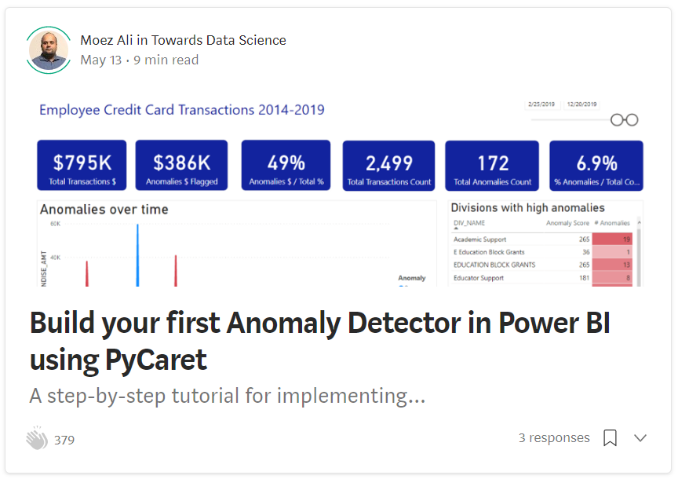
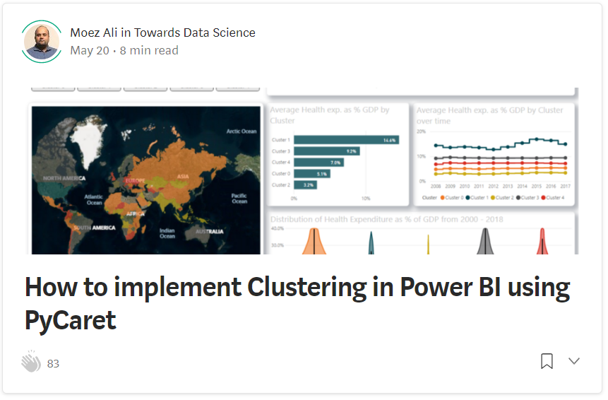
Resources
https://towardsdatascience.com/build-your-first-anomaly-detector-in-power-bi-using-pycaret-2b41b363244e
https://towardsdatascience.com/how-to-implement-clustering-in-power-bi-using-pycaret-4b5e34b1405b

Slide 5
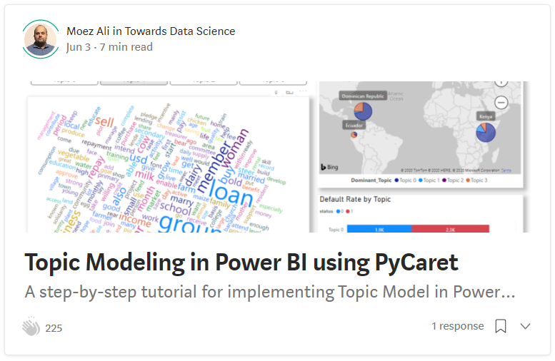
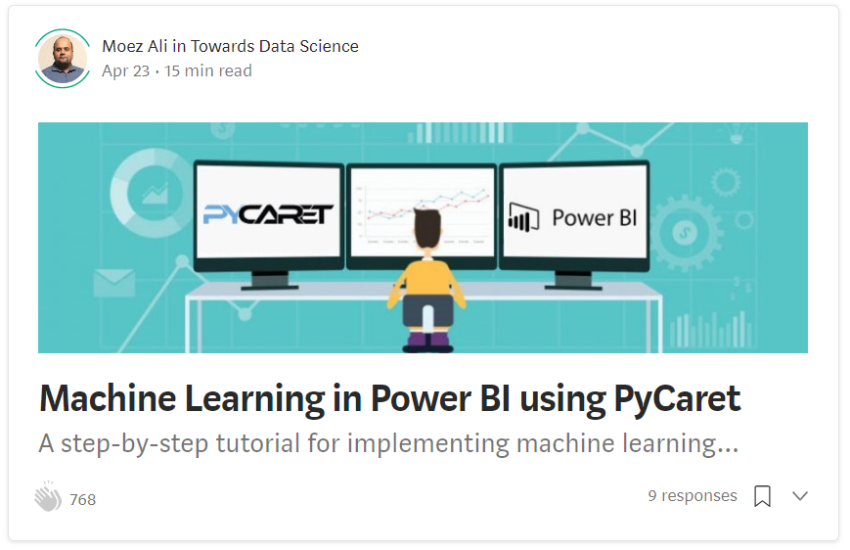
Resources (cont.)
https://towardsdatascience.com/topic-modeling-in-power-bi-using-pycaret-54422b4e36d6
https://towardsdatascience.com/machine-learning-in-power-bi-using-pycaret-34307f09394a

Slide 6
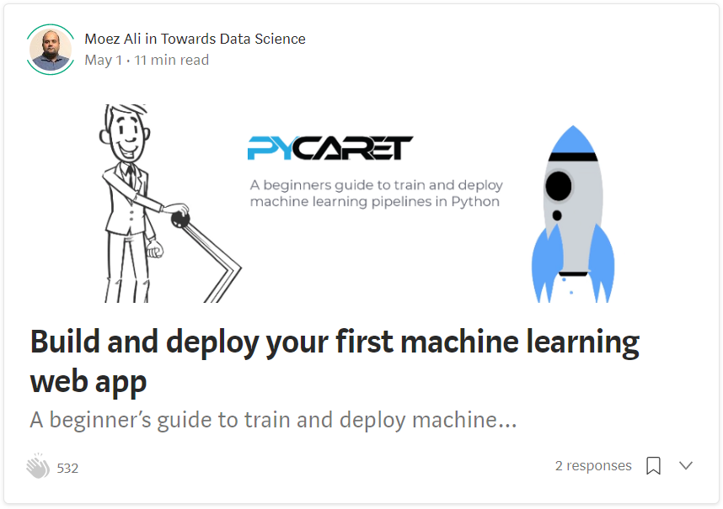
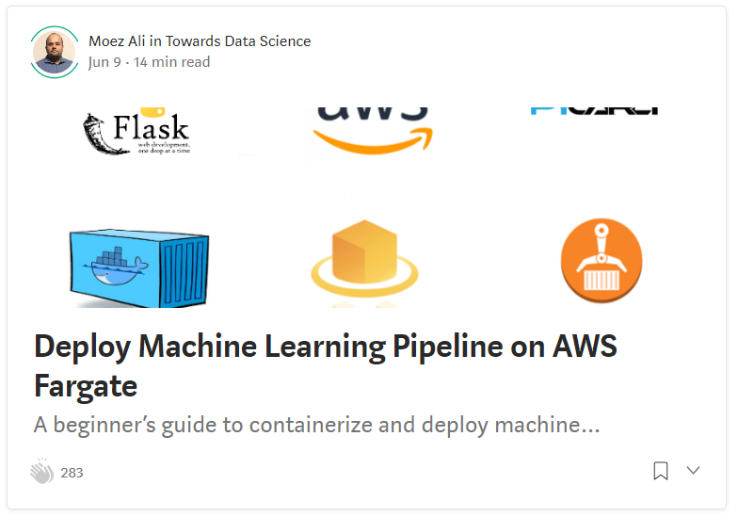
Resources (cont.)
https://towardsdatascience.com/build-and-deploy-your-first-machine-learning-web-app-e020db344a99
https://towardsdatascience.com/deploy-machine-learning-pipeline-on-aws-fargate-eb6e1c50507

Slide 7

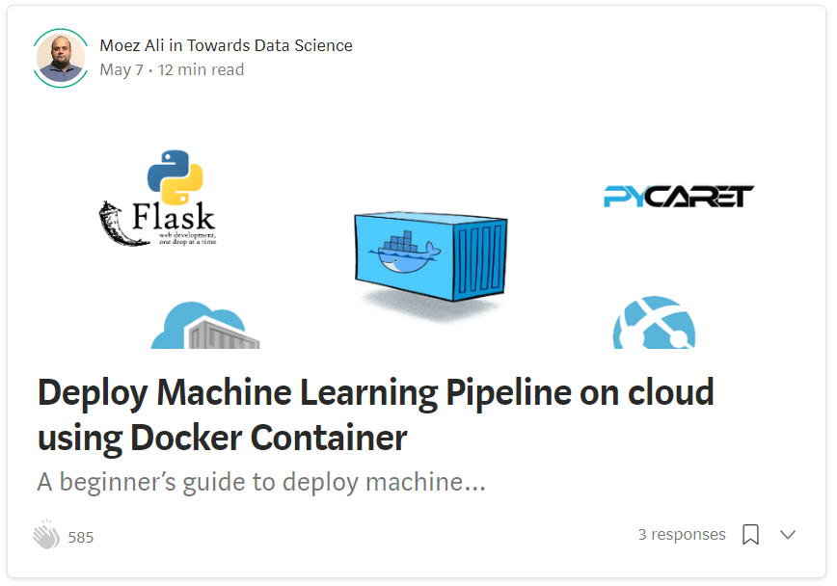
Resources (cont.)
https://towardsdatascience.com/deploy-machine-learning-model-on-google-kubernetes-engine-94daac85108b
https://towardsdatascience.com/deploy-machine-learning-pipeline-on-cloud-using-docker-container-bec64458dc01

Slide 8
Resources (cont.) – Official Video Tutorials
Binary Classification Video Tutorial
https://www.youtube.com/watch?v=2xAgLKUN6Xs
Clustering in PyCaret Video Tutorial
https://www.youtube.com/watch?v=2oxLDir7foQ
Anomaly Detection in PyCaret Video Tutorial
https://www.youtube.com/watch?v=q0dxYDq1A40&t=2s
Topic Modeling in PyCaret Video Tutorial
https://www.youtube.com/watch?v=G6ShuoM3T1M
Association Rule Mining in PyCaret Video Tutorial
https://www.youtube.com/watch?v=XYAGwts5qGw

Slide 9
Resources (cont.)
Machine Learning in SQL by Umar Farooque
https://towardsdatascience.com/machine-learning-in-sql-using-pycaret-87aff377d90c
PyCaret’s integration with Tableau by Andrew Cowan-Nagora
https://towardsdatascience.com/machine-learning-in-tableau-with-pycaret-166ffac9b22e
NLP Classification using PyCaret by Prateek Baghel
https://towardsdatascience.com/predicting-crashes-in-gold-prices-using-machine-learning-5769f548496
Predict Gold Price Returns using PyCaret by Riazuddin Mohammad
https://towardsdatascience.com/machine-learning-to-predict-gold-price-returns-4bdb0506b132
Predict Crashes in Gold Price using PyCaret by Riazuddin Mohammad
https://towardsdatascience.com/predicting-crashes-in-gold-prices-using-machine-learning-5769f548496

Slide 10
Resources (cont.)
Binary Classification Notebook by Murali Tedla
https://colab.research.google.com/drive/1W6ZYw5oAN7V85utFkXkCQq3iBWjqP1WB
Wine Quality Prediction by Abhinav Arora
https://colab.research.google.com/drive/1uFNmhgM9ghVrtqN3MXaofxDlLePb3yIi#scrollTo=sYsHyY8uH6tb
Build your machine learning models by Lakshay Arora
https://www.analyticsvidhya.com/blog/2020/05/pycaret-machine-learning-model-seconds/
PyCaret’s Integration with Power BI (1 Hour Video Tutorial)
https://www.youtube.com/watch?v=ZeQVkEWo2x0
Anomaly Detection using PyCaret by Krish Naik (Video Tutorial)
https://www.youtube.com/watch?v=ZeQVkEWo2x0

Slide 11
What do you need to follow along?
Anaconda Distribution with Python 3.6 or greater.
Download: https://www.anaconda.com/products/individual
Power BI Desktop
Download https://powerbi.microsoft.com/en-us/downloads/
PyCaret
Install https://www.pycaret.org/install

Slide 12
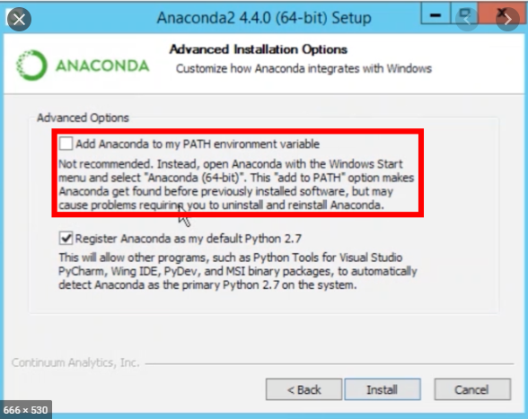
Remember to add it to PATH

Slide 13
Create Environment and Install PyCaret
Execute following code in Anaconda Terminal:
conda create --name powerbi python=3.7
conda activate powerbi
pip install pycaret
https://www.pycaret.org/install

Slide 14
Do you have this?
Power BI Desktop
Anaconda / Python 3.6 or greater
Conda Environment
PyCaret

Slide 15



What is PyCaret?
PyCaret is an open source, low-code machine learning library in Python that aims to reduce the cycle time from hypothesis to insights. PyCaret can be used for rapidly developing and deploying machine learning pipeline.
EASY TO USE
PRODUCTIVITY TOOL
BUSINESS READY

Slide 16
How to? theoretically
Power BI and almost any other tool out there gives ability to execute Python / R scripts.
PyCaret has magic functions that supports execution of ML package into these tools.
Ideally, it is best to implement in ETL pipeline such as Power Query, Alteryx, KNIME, Informatica, SQL Server etc.
Use for batch processing.

Slide 17
What is Clustering?
Clustering is a technique that groups data points with similar characteristics. Organizing data into clusters helps in identify underlying structures in the data and finds applications across many industries. Some common business use cases for clustering are:
✔ Customer segmentation for the purpose of marketing.
✔ Customer purchasing behavior analysis for promotions and discounts.
✔ Identifying geo-clusters in an epidemic outbreak such as COVID-19.

Slide 18
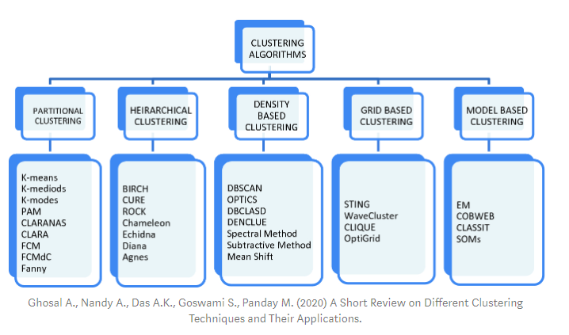
Types of Clustering

Slide 19
Example 1 – Jewellery Customer Dataset
https://raw.githubusercontent.com/pycaret/pycaret-demo-eb/master/jewellery.csv

Slide 20
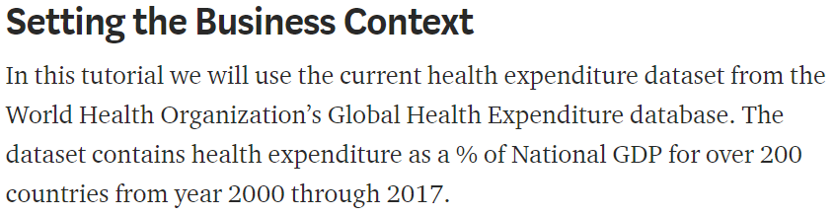
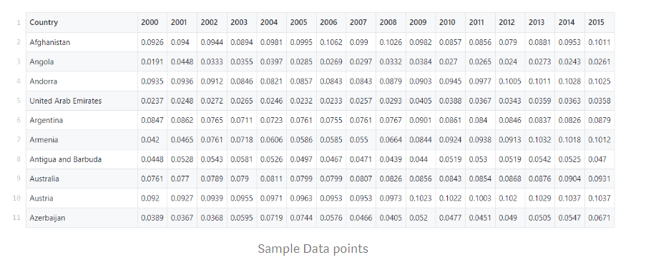
Demo # 1 – WHO Global Health Expenditure Database

Slide 21
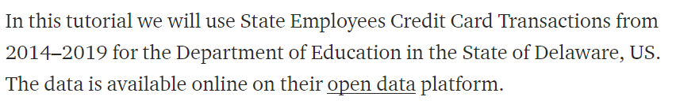
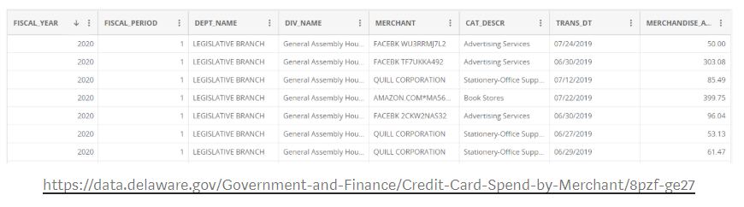
Demo # 2 – Dept of Education – State of Delaware, US
TIME-PERMITTED

Slide 22
Thank you – Questions?

